Slide 1

Applied Data Science Capstone
The Battle of Neighborhoods
Coursera | IBM Data Science Professional Certificate Specialization | 30/12/2018

Slide 2
Introduction
The current study will try to provide an optimum location for opening a new business in a specific city, based on:
A neighborhoods property, e.g. the second most common language spoken (after English) in the neighborhood,
The number of competitors in the neighborhood,
The population density in the neighborhood,
The average income of the neighborhood.

Slide 3
Data description
The datasets that will be used are for retrieving information about city's neighborhoods and their characteristics are taken from Wikipedia website for the Toronto demographic information:
https://en.wikipedia.org/wiki/Demographics_of_Toronto_neighbourhoods
The geographic coordinates of the neighborhoods of Old Toronto are taken from:
File ‘List_neighborhood_Toronto.csv' which the latitude and longitude per neighborhood in Toronto area.

Slide 4
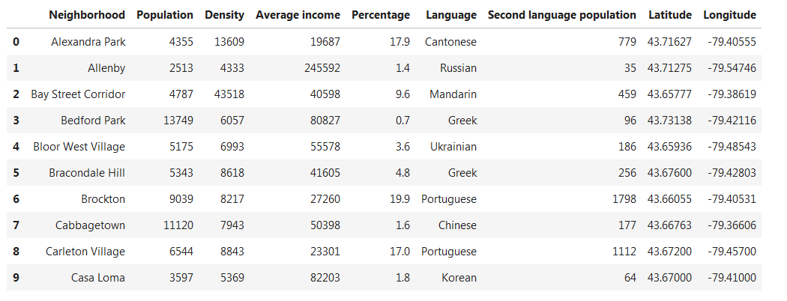
Methodology
Data wrangling
For first step, the information in the Wikipedia link has to be
transformed in a suitable form that enables further dataframe
analysis.
Add coordinates to the demographic data
Add latitude and longitude data, by merging the demographic
dataframe and the neighborhoods.
The result is the following dataframe.

Slide 5
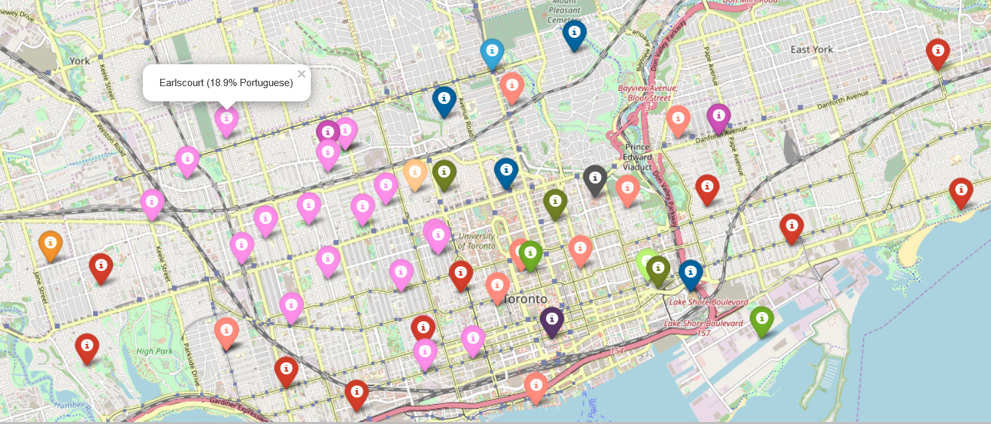
A map depicts the neighborhoods, as shown below:

Slide 6
Foursquare API
Use the Foursquare API, to get the venues for each neighborhood.
Further filter for limiting to “Restaurants” only.
Assume language groups:
For Portuguese assume common ethnic group for Brazilian and Portuguese Restaurants.
For Japanese assume common ethnic group for Sushi and Japanese Restaurants.
For Cantonese assumed common ethnic group for Thai, Taiwanese, Vietnamese, Cantonese, Indonesian Restaurants.
For Mandarin as Chinese for Chinese Restaurant.

Slide 7
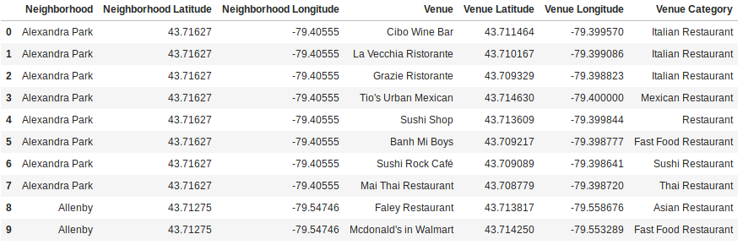
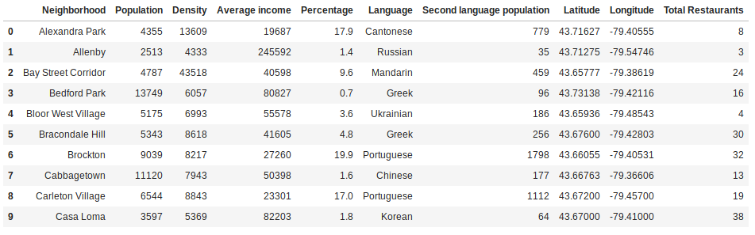
The competition per area:
The summary of total restaurants per area and competition:

Slide 8
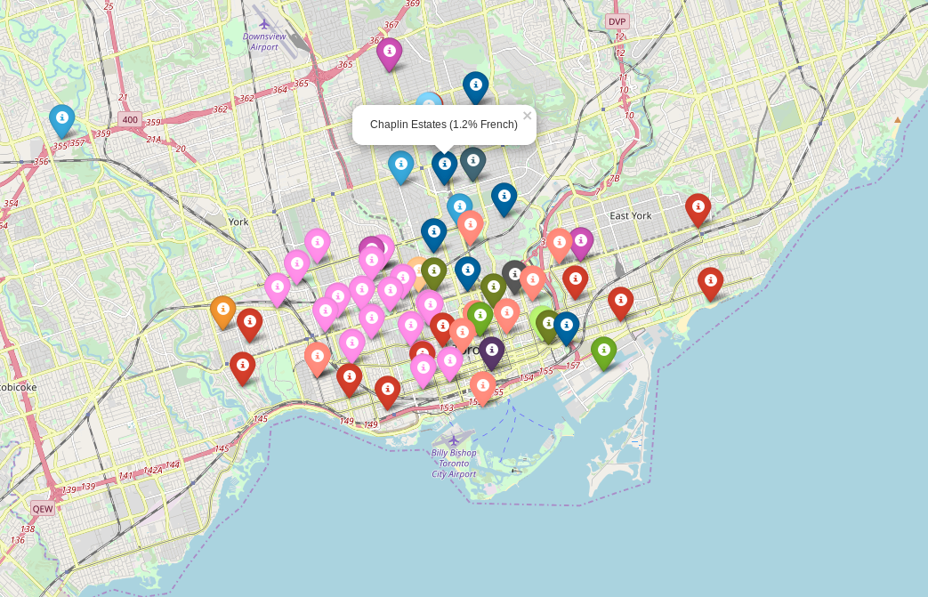
We can then visualize in a map the number of competitors for each neighborhood:

Slide 9
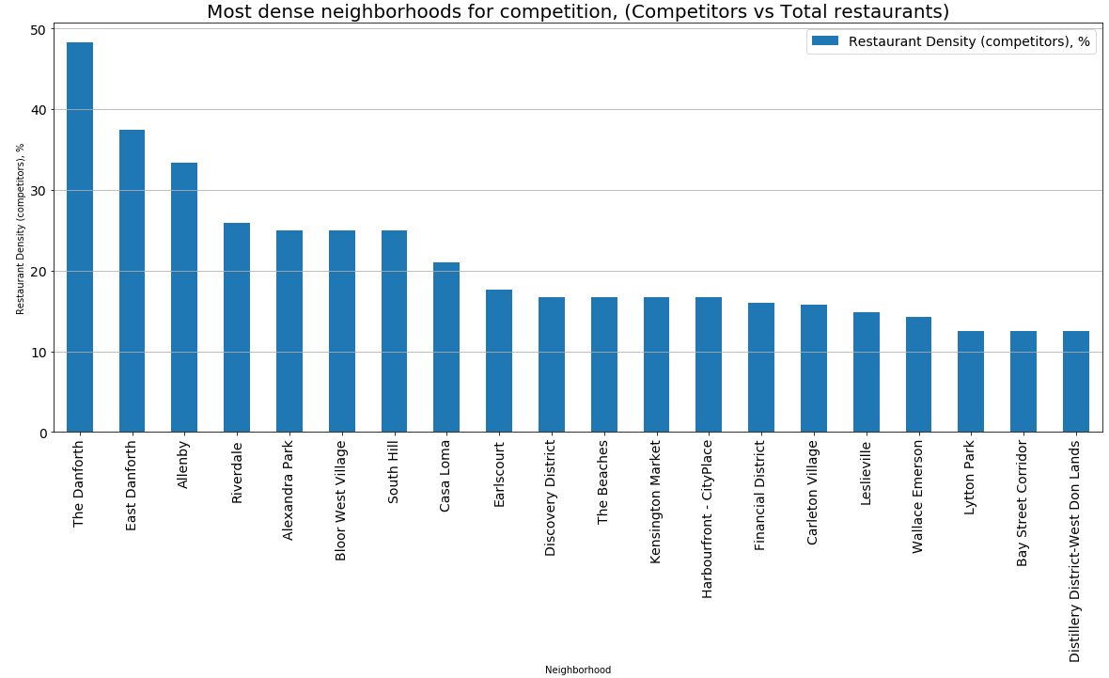
Weight factors (1/2)
Density of ethnic group restaurants

Slide 10
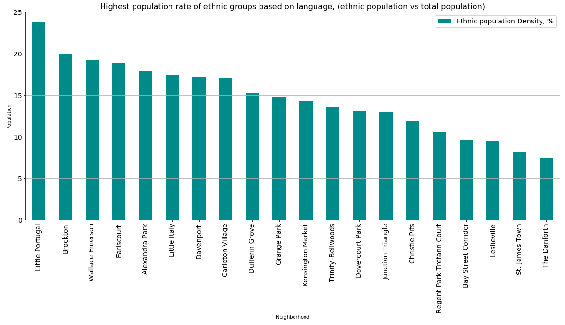
Weight factors (2/2)
Density of ethnic population

Slide 11
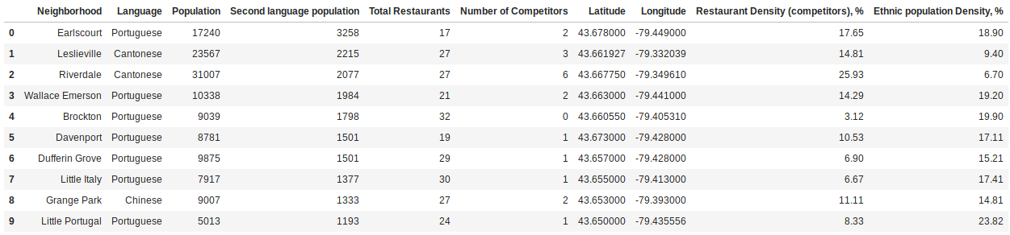
The original dataframe has been updated with the 2 weight factors as follow:

Slide 12
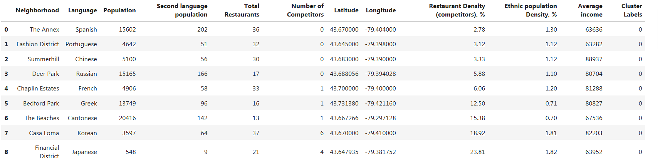
Results
Analysis of results by machine learning (k-means)
k = 5 clusters
Cluster0

Slide 13
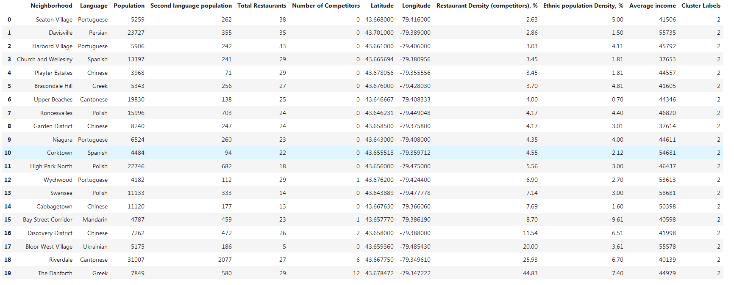
Cluster1
Cluster2

Slide 14
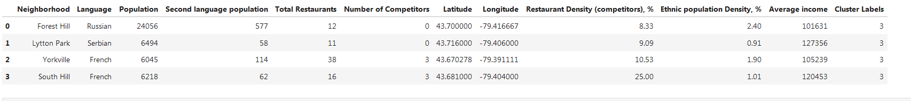
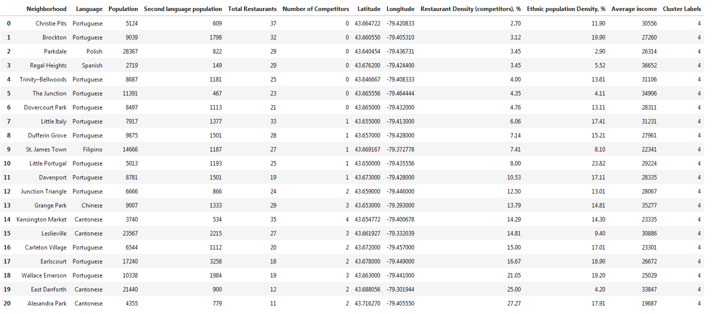
Cluster3
Cluster4

Slide 15
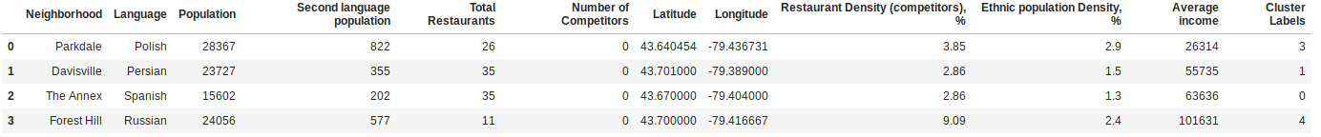
Discussion/Conclusion
The best option to open an ethnic Persian restaurant is “Davisville”. This area has less competition, and second best population from other candidates. It is in area with average income, i.e. can attract better all classes equally, in contrast to “Forest Hill” which seems rather expensive.
The ‘Average income’ was the most distinctive property for the neighborhoods, more important than other significant properties such as the population. Below the best candidates, based on “Average income”:

Slide 16
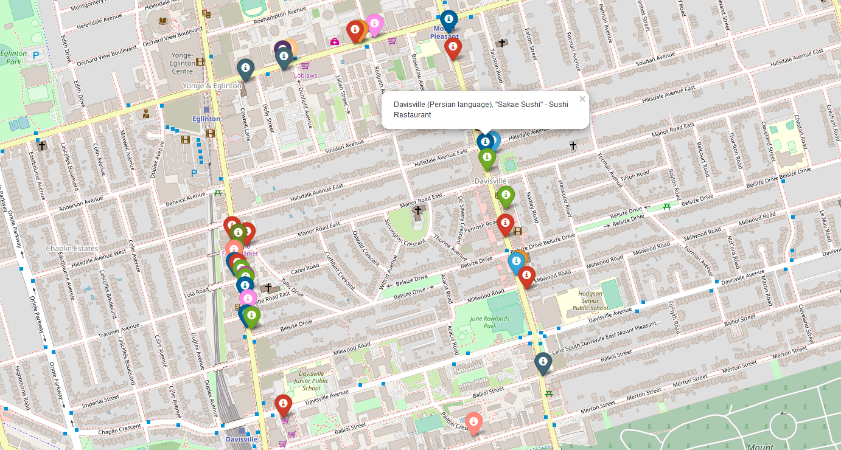
Below a map of competition in Davisville:

